Slide 1
CASE MANAGEMENT
COST BENEFIT ANALYSIS
NEGOTIATION SKILLS
TAX COURT TIPS

Slide 2
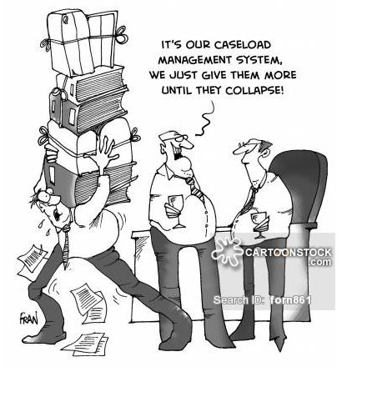
CASE MANAGEMENT
Who has an established system or process?
Who doesn’t?
  If you don’t, how are you managing your filings?
  Do you think it’s working for you or are you making it work because that’s the way it has always been?

Slide 3
Case Management
Likely your office already has an established process
  Is you current process really current? When was the last time you revisited them? Are you just doing things because that’s the way they have always been done?
  If not, consider updating and establishing a set process
  Consider adding outlook tasks & alerts
You could utilize both…
  Electronic tracking form for each case
  Excel file with a more detailed condensed tracking system
Both are initially labor intensive, but are huge time saving tools

Slide 4
TAX PETITION WORKFLOW
The Tax Court procedure that was developed for petitions filed for payable 2013 is the foundation for this workflow.
Dates listed reflect a petition filed for pay 2016.
In an effort to maintain the highest possible level of customer service throughout the litigation process, petitions will be processed using the first in first out (FIFO) processing method. This is subject to change with a petition that is part of a previous settlement.
April 30, 2016 –
Filing deadline is on or before April 30 of the payable year.
County Assessor - A list of current payable year petitions is entered on the petition tracker. Each appraiser will be responsible for creating a tax file for each of their petitions.

Slide 5
May 15, 2016 –
Petitioner must pay first half tax.
Tax Division - generates the list of non-payment of first half taxes and distributes to the Deputy County Assessor.
County Assessor - The Deputy County Assessor compares the list to the list of current year petitioners in order to identify the petitioners that have not paid their first half taxes.
County Assessor/County Attorney - Process for dismissal is in place for non-payment of first half taxes. These documents are not filed with the Court until the following year. A petitioner can legally pay the first half taxes up to a year after they are due and have the petition reinstated.

Slide 6
August 1, 2016 –
Petitioner is required to share with the Assessor’s Office income/expense information for all income producing property under petition.
County Assessor – Process for dismissal is in place if petitioner does not share this information.
The appraiser assigned the petition should compare what has been provided to this point with what information will needed to review the value or classification under appeal. The deadline for informal discovery is May-June.
August 1, 2016 –
A list of petitions that were improperly filed will be compiled by the Assessor’s Office and shared with the County Attorney’s.

Slide 7
October 15, 2016 –
Petitioner must pay 80% of second half tax bill.
County Assessor receives a list from the Taxation Division that lists all petitioners that have not pay at least 80% of the second half tax bill. A list is compiled and shared via email with the County Attorney’s.
Process for dismissal is in place for non-payment of 80% of second half tax. We wait to file the affidavit until a year after the October second half due date. This is an automatic dismissal.
If the petitioner has paid the taxes within the one year window they are responsible for having the petition reinstated.

Slide 8
April 2017
The Tax Court has indicated that they will start distributing the scheduling orders to the County’s 12 months after the filing deadline has passed.
County Attorney - Distributes the scheduling orders to the Assessor.
County Assessor – Upon receipt the scheduling order is recorded, assigned an appraiser and distributed to staff. The County Attorney should be notified via email the list of assignments.
April 2017
In cases that involve a tax rep, obtain a signed “INFORMED CONSENT FOR THE RELEASE OF NOT PUBLIC /PRIVATE DATA & AUTHORIZATION FOR DATA RELEASE & EXCHANGE” form. There is no need to wait until this date if you are notified sooner from a tax rep.

Slide 9
May-June 15, 2017 –
Deadline for sending an informal discovery request if desired. There is no need to wait until this date to notify the Attorney’s Office of the documents that you need.
County Assessor - The appraiser will determine the documents needed to review the valuation and classification that is under petition. The appraiser assigned the appeal will send an email to the assigned Attorney specifying the information needed. The subject line of the email must be in the following format – CITY/PETITIONER/CASE NUMBER/PAYABLE YEAR.
County Attorney – The County Attorney’s Office will send out a letter to the petitioner requesting only the documentation determined by the appraiser. Informal discovery should have a deadline for response – 60 days.
The emphasis at this step in the process is that the appraiser determines if this step is necessary and what specific documents are to be requested.
It will be discussed after the 60 days whether or not to file formal discovery if the information requested is not shared.

Slide 10
May-June 30, 2017 -
Create working file for each petition. Include determination of highest & best use, pull sales comparable, and pro-forma.
May-July 30, 2017 -
Deputy Assessor to review with appraiser their work file and determine if a case can be expedited.
July 2017 – September 2017
County assessor shall contact the petitioner to request an inspection of the property. The inspection shall take place no more than 90 days from the date of the scheduling order.
The assigned appraiser must let the County Attorney know when the inspection request is scheduled and when the inspection has been completed.

Slide 11
August 2017 –
The County Attorney will provide the petitioners attorney with the identity of the County appraiser/expert.
Each party shall notify all other parties and the court in writing within 10 days of retention of an appraiser or other expert and shall disclose the identity of the appraiser/expert retained, the subject(s) on which the appraiser/expert will opine, and the date on which the expert was retained. Failure to comply with this requirement may result in exclusion of the appraisal or expert report and the appraiser's or expert's testimony.
If the petition is reassigned a new notification will be sent.

Slide 12
October 2017 – December 2017 - Trial ready date minus 4 months
Joint statements are due to Tax Court four months prior to the trial ready date.
The Tax Court in their scheduling orders has described this step in the process as follows:
The issues to be resolved by the court at trial;
The identity of all experts retained;
The name, address, and telephone number of each lay or fact witness, separately identifying those the party expects to present and those it may call only if need arises;
The estimated duration of trial;
Any other information relevant to the scheduling of this matter.
County Attorney – Joint statements are primarily standardized legal documents and are completed by the County Attorney’s Office.

Slide 13
New 10/2013 - For all pretrial, trial and post-trial documents on each case, the court is requiring the parties to file the original, plus two hardcopies (so 3 hard copies for each doc), and a cd or flash drive containing an electronic searchable version of the document (which could easily add up to 5 or more cds or flash drives that would need to file per case).
County Assessor – The Assessor’s Office will work closely with the Attorney’s Office to answer any questions on the joint statement that are not boiler plate or legal related. Any requests that involve appraiser contribution should be sent via email through the Deputy County Assessor and all commercial staff should be copied.
The areas of the joint statement in question should be highlighted and a reasonable turnaround time included in the email. The subject line of the email must be in the following format – CITY/PETITIONER/CASE NUMBER/PAYABLE YEAR.
Upon receipt of the joint statement, the tax court administrator will schedule the trial in this matter and will notify the parties of the trial ready date. The parties should expect that the case will be tried within 60 days of the trial ready date and should plan their availability and the availability of their experts and other witnesses accordingly.

Slide 14
October 2017 – December 2017 - Trial ready date minus 4 months
This is a strategy meeting involving staff from both offices. Discussion will include the need for any upcoming formal discovery requests and status updates relating to any information that we may have or may not receive to this point. For example, did we receive the informal discovery documents that were requested, were we granted our request for an inspection, etc?
County Attorney – The administrative staff in the Attorney’s Office will schedule via email a convenient meeting time for those involved.
November 2017 – January 2018 - Trial ready date minus 3 months
Discovery must be filed no later than trial ready date minus 3 months. The Assessor’s Office would like to emphasize that discovery requests should be used for specific document(s) only. The information that the appraiser determines to be part of informal or formal discovery should assist in preparing an appraisal. This point of emphasis must be consistent regardless of which Attorney has been assigned the appeal.

Slide 15
Discovery request that go unanswered by petitioner –
The County Attorney’s Office has agreed to be more aggressive in pursuing the requested documents when our request goes unanswered. This should be a discussion item during the strategy meeting.
Discovery requests served by the petitioner –
The majority of discovery requests received can be answered with boiler plate responses to general legal questions by the Attorney’s Office with no involvement from the Assessor’s Office.
When a discovery request includes specific questions related to the property under petition or a reasonable request for a relevant report the Assessor’s Office will work closely with the Attorney’s Office to answer the request in a timely manner.
All discovery responses will originate in the Attorney’s Office. If there is specific information needed from the Assessor’s Office the request should be emailed to the Deputy County Assessor and all commercial staff should be copied.
The document should highlight the areas that need to be completed. All correspondence should include a reasonable deadline for completion. If the Assessor needs any additional time that should be shared with the Attorney’s Office as early in the process as possible.
All final responses shall be served by the County Attorney’s Office.

Slide 16
December 2017 – February 2018 - Trial ready date minus 8 weeks
If the two parties are still in disagreement the court sets an appraisal exchange date. The appraisal exchange is 8 weeks prior to the trial ready date. In addition to submitting a trial ready appraisal both parties will report to the court any experts that they have retained as expert witnesses – referred to as the expert report.
Appraisal is performed –
County Assessor – The decision to write an appraisal or not lies with the Assessor. The merits of this decision will have already been discussed at the strategy meeting.
After our internal review has been completed the assigned appraiser will make 4 copies of their report, have it bound by either the County’s print shop or FedEx/Kinkos. The copies are to be personally delivered to the Attorney’s Office 24 hours prior to the date set as the exchange date by the Tax Court.
The appraiser is responsible for scanning the appraisal and saving it in the appropriate shared drive folder.
County Attorney – The Attorney’s office couriers the report to the required parties prior to the noon deadline.

Slide 17
Appraisal received –
County Attorney – The review of the submitted report is an important element of the trial preparation meeting that will take place in one week. All submitted reports should be scanned and the pdf placed on the shared drive. The report should be available to the Assessor’s Office by noon the day after the appraisal exchange date. The Attorney’s administrative staff member should also send an email to the Deputy County Assessor and copy all commercial staff appraisers notifying them that an appraisal has been received and is available on the shared drive.

Slide 18
Trial ready date minus 3 weeks –
Trial preparation discussion - appraisal review, cross examination assistance provided to assigned Attorney.
Trial ready date minus 2 weeks –
Any objection to the competency of an appraiser or expert or to the admissibility of any portion of an appraisal or expert report shall be made in writing, served upon the proponent of the appraisal or report, and filed with the court no later than two weeks prior to the trial ready date. This is a function of the Attorney’s Office based on the discussion coming out of the trial preparation meeting.
Trial ready date minus 1 week –
The proponent may file and serve a response no later than one week after the objection is filed with the court or week prior to the trial ready date.

Slide 19
Trial ready date minus 2 to 1 week(s) –
See “New Scheduling Order 3-2014” located in the Assessor Reference Manual for other requirements relating to motions, stipulations, pre-trial briefs, filing of documents and pre-trial conferences.
February 2018 – April 2018 (Order Date plus 12 months) –
If the case is not settled or dismissed it shall be trial ready.
3 days prior to trial –
Final preparation meeting.
*** The Tax Court may make further changes to the process outlined above based on their experiences.

Slide 20
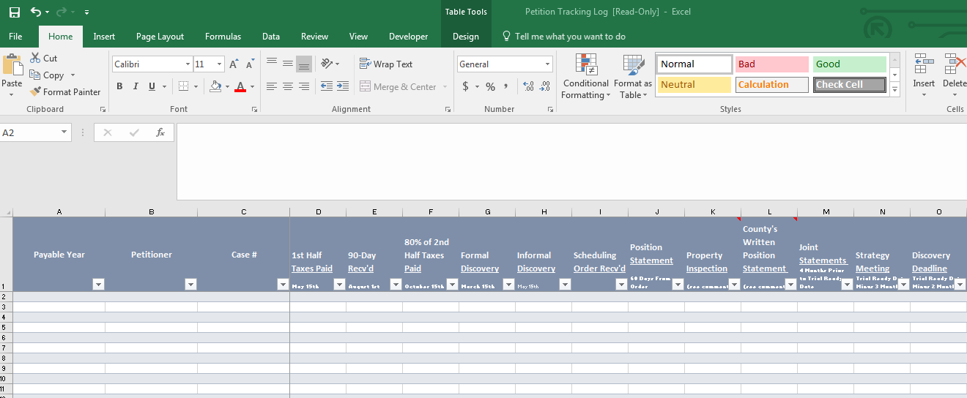
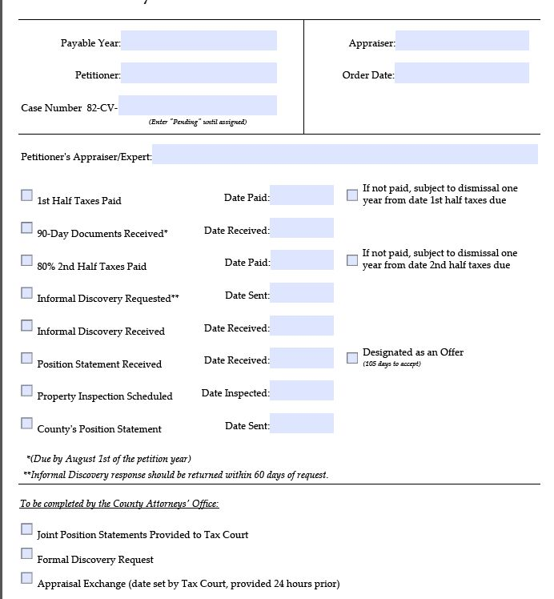

Slide 21
COST - BENEFIT ANALYSIS

Slide 22

Cost-Benefit Analysis
“…a systematic approach to estimating the strengths and weaknesses of alternatives; it is used to determine options that provide the best approach to achieve benefits while preserving savings.”
-Wikipedia

Slide 23
Cost-Benefit Analysis
What are the benefits?
(Benefit to the Citizens/Taxpayers)
Fair and equitable tax burden allocation is the primary benefit sought by assessors…

Slide 24

A Four House Town
Individual Value Impact
(appealed property example)
Assume that the various entities and taxing districts (City, County, School, etc.) require a total of $4,000 to operate
EMV = $100,000
EMV = $100,000
EMV = $75,000
EMV = $100,000
TAXES = $1,000
TAXES = $1,000
Individual Value Reduced $25,000
TAXES = $800
TAXES = $1,067
EMV = $100,000
EMV = $100,000
EMV = $100,000
EMV = $100,000
TAXES = $1,000
TAXES = $1,000
TAXES = $1,067
TAXES = $1,067

Slide 25



Cost-Benefit Analysis
(Benefit to the Citizens/Taxpayers)
Changes to estimated values carry forward with the impact of shifting who pays what portion!
Because Tax Representatives and Tax Attorneys are interested in making money, they are aggressively pursuing the most lucrative potential clients. This results in many formal appeals on higher value and higher tax rate property types.
Put another way, the “average” taxpayer is not represented by a powerful attorney who aggressively advocates to lower their property tax burden every year.
As assessors we must do our best to keep accurate values in place. If the value is incorrect, fix it, don’t be attached to assessed values. But when the appeal is without merit, keep the collective taxpayer’s best interests in mind.

Slide 26
Cost-Benefit Analysis
County/City Employee (Cost to the Citizens/Taxpayers)
Attorney
Meetings/Consultations
Assessor / Appraiser
Other Experts
(ex. city planner)
Discovery Requests and Responses
Pre-trial conferences
Pre-trial briefs
Trial preparation
Trial
Post-trial Briefs
Oral arguments
Request for amended findings
Supreme court appeals
Etc.
Meetings/Consultations
Discovery Requests and Responses
Appraisal
Trial preparation
Trial
Pre-trial briefs
Post-trial Briefs
Oral arguments
Request for amended findings
Supreme court appeals
Etc.

Slide 27
Cost-Benefit Analysis
Hiring an Expert Appraiser
(Cost to the Citizens/Taxpayers)
?
$35,000
$20,000
Anticipate roughly $20,000 at a minimum.
This is probably more typical of an “average” expense to hire an expert appraiser accompanied by trial prep and testimony.
A very basic commercial or industrial property appraisal and trial prep/testimony.
The sky is the limit…
Depending how large/complex/remote the situation, the cost can increase substantially.

Slide 28
Cost-Benefit Analysis
Hiring an Expert Attorney
(Cost to the Citizens/Taxpayers)
?
?
?
Anticipate roughly $XX,XXX at a minimum.
This is probably more typical of an “average” expense to hire an expert attorney…
A very basic commercial or industrial property.
The sky is the limit…
Depending how large/complex/remote the situation, the cost can increase substantially.

Slide 29
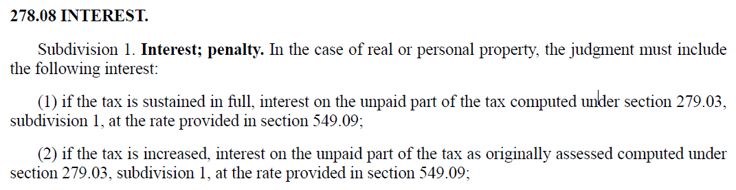
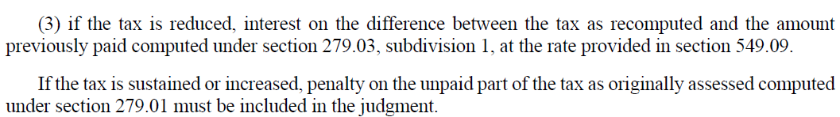

Cost-Benefit Analysis
Interest
(Cost to the Citizens/Taxpayers)

Slide 30
Cost-Benefit Analysis
What are the costs?
(Cost to the Citizens/Taxpayers)
Costs
Sunk
Already incurred and cannot be recovered.
Potentially Recapturable
An incurred cost that has the potential of being reimbursed.
Prospective
Potential future costs.
(recapturable?)

Slide 31
Cost-Benefit Analysis
What are the risks?
By far, the greatest risk is incurring all of the costs of a trial on behalf of the taxpayer, and receiving a decision that is equal to or worse than what could have been achieved through a settlement.
For this reason it is important to study and understand the behavior of the tax court by reviewing decisions and considering potential, and likely outcomes.
What is the current assessed value, what is the effective tax rate, how far apart are we, what are the potential tax dollars associated with potential outcomes?
Who is the judge, have they ruled on a similar case?
Who is the opposing attorney, what is their track record at trial?
Are the appropriate resources and experts available?

Slide 32
Cost-Benefit Analysis
What are the risks?
By far, the greatest risk is incurring all of the costs of a trial on behalf of the taxpayer, and receiving a decision that is equal to or worse than what could have been achieved through a settlement.
For this reason it is important to study and understand the behavior of the tax court by reviewing decisions and considering potential, and likely outcomes.
What is the current assessed value, what is the effective tax rate, how far apart are we, what are the potential tax dollars associated with potential outcomes?
Who is the judge, have they ruled on a similar case?
Who is the opposing attorney, what is their track record at trial?
Are the appropriate resources and experts available?

Slide 33
Cost-Benefit Analysis
What are the risks?
It is not enough to simply believe that the assessed value is accurate…
It is not enough to know that the assessed value is accurate…
Disadvantages for government (on behalf of all taxpayers)
Only a handful of counties or cities have attorneys who are practiced in the tax court arena, and most of those attorneys are not dedicated full time to this arena.
  The vast majority of petitioners are represented by teams of attorneys and experts who work solely in this arena full-time.
When working on a court case, you or your staff are not working on the property assessment. It’s difficult to acquire additional resources, with deadlines, limited resources, and limited expertise it’s often a balancing act that favors making concessions that are not believed to be warranted.

Slide 34
Cost-Benefit Analysis
In Summary…
Compare the estimated costs of an appraisal and trial with the lowest possible settlement option.
Refund
+
Interest
+
Appraisal
+
Staff Salary and Benefits
+
?
Refund
+
Interest

Slide 35
NEGOTIATION SKILLS

Slide 36
Always adhere to your employers policies and procedures
The negotiation skills discussed within this material is provided as a guide…
to help you move beyond a deadlock.
They are not intended to replace your employer’s pre-existing
policies and procedures.

Slide 37
SO IT BEGINS…
The appeal has been filed
The petitioner has met the initial 90-day rule of production of documents
You have reviewed all of their data and determined whether additional information is needed in order for you to complete your analysis
You have reviewed the subject of your appeal on-site with the petitioner’s representative
You have completed a Market Analysis
You have reviewed the Subjects Highest and Best Use

Slide 38
…AND…
You have determined if
  There are sufficient sales to support a Sales Comparison Approach
  Will the Cost Approach be needed and if so,
    You have received all of the pertinent data and land sales (do I have the building plans? Can I identify the components to complete this approach?)
  The owner’s actual Income and Expense data, along with the Market Data, are reflective of the Market
    And you have completed an Income Proforma based on this data
Now, based on this data, is a change warranted?

Slide 39

Questions for you to go through:
What is your range of Market Value based on the data? Does it warrant a change?
Has the Petitioner provided you any idea of where they feel the “market value” is?
  Is their opinion within your range of Market Value? If so, what are you waiting for?
Based on the level of complexity, you may need to see if they are willing to come into your office and sit down to discuss the property.

Slide 40
Questions for you to go through continued:
RATIO … Does it apply? Do you know how to apply it?
  The Tax Court uses sales ratios to measure the accuracy of the assessor’s assessment. It uses a 9-month study of sales occurring from January 1 to September 30 of a given year compared to the assessor’s market value for that year. For example, the 2016 Tax Court ratios used sales occurring January 1, 2016 – September 30, 2016 which are compared to the January 2, 2016 assessor’s estimated market values.
  Ratio only applies IF you have it.
  IF your opinion of Market Value exceeds the Assessed Value under appeal –
    Ratio DOES NOT apply.

Slide 41
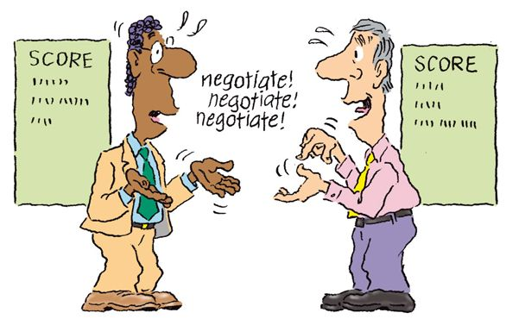
Negotiating Skills
We use negotiation skills almost everyday to communicate with others and to reach a bargain or deal of some sort (whether we realize it or not).
However, negotiation is a special kind of communication because it uses a number of very difficult tactics and methods.
In order to be successful in our negotiations, some prior clarity about what we really want or hope to accomplish is always a good idea.

Slide 42
Ask them to identify their expectations and provide you with the information that they would like you to consider prior to meeting.
Do your own research. Verify the data that they have already provided and identify potential data that you will use to support your position.

Slide 43
If they are willing to discuss settlement, let them present their position first.
BURDEN OF PROOF
The assessor’s estimated market value is prima facie valid. Petitioner may overcome this presumption by introducing credible evidence as to the subject property’s market value.
The government’s assessment of real property is prima facie valid.24 “A prima facie case simply means one that prevails in the absence of evidence invalidating it.” 25 The taxpayer has the burden of overcoming prima facie validity by “offer[ing] evidence to invalidate the assessment.” 26
24 Minn. Stat. § 271.06, subd. 6 (2012) (“[T]he order of the commissioner or the appropriate unit of government in every case shall be prima facie valid.”); Minn. Stat. § 272.06 (2012) (an assessment is “presumed to be legal until the contrary is affirmatively shown”); see also S. Minn. Beet Sugar Coop v. Cnty. of Renville, 737 N.W.2d 545, 557 (Minn. 2007).
The classification of real estate as determined by the County Assessor’s Office is presumed to be valid. Petitioner bears the burden of overcoming that presumption.

Slide 44

Before YOU enter the room:
What is your role? Are you the Appraiser and the Attorney? Or just the Appraiser?
  Some jurisdictions act as both the Appraiser and the Attorney by handling all of their own negotiation settlements.
Knowing what role you play is very important. Each wears a different hat.
An Appraiser
  - neutral
  - unbiased opinion
  - not advocating – its your opinion
An Attorney
  - advocate for their client (us the assessor)
  - provide legal counsel

Slide 45
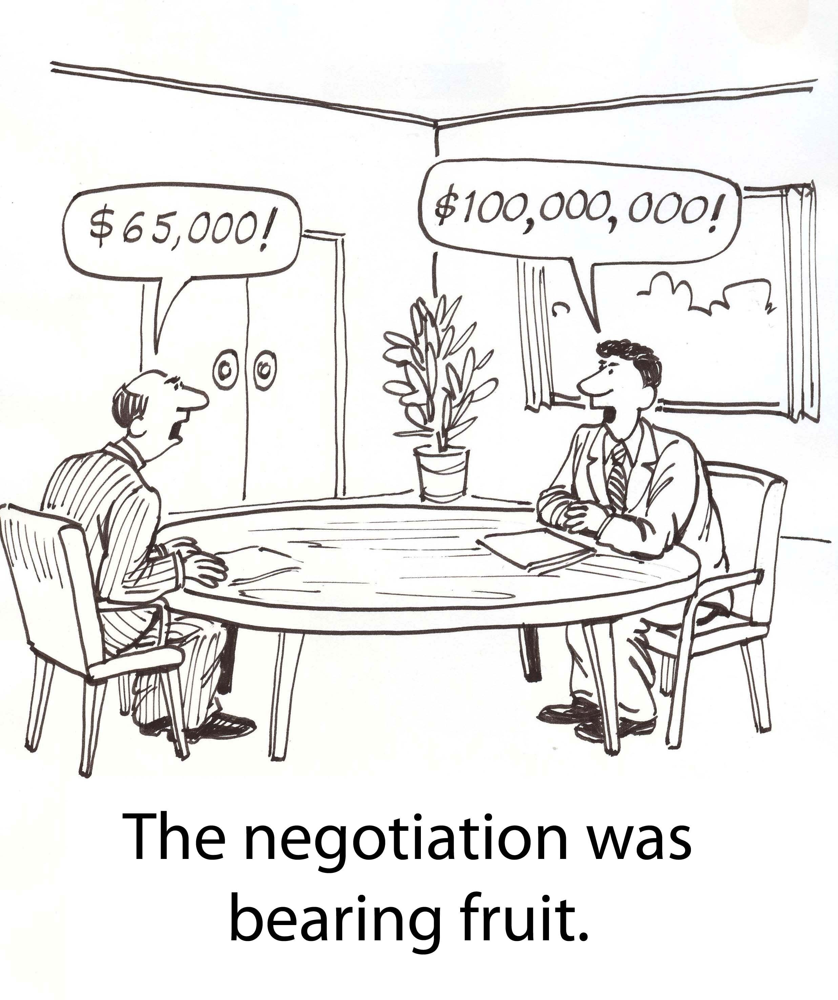
We’re all entitled to our own opinion. As much as you think you are right, they think they are right.
Let them speak and you listen. This is their opportunity to explain their position.
What FACTS can you agree on?
It’s ok to agree to disagree.
You do not need to make a decision immediately.
Thank them for taking the time to meet with you and provide them a timeframe when they should expect to hear back from you.

Slide 46
REFLECT - DECOMPRESS
After the meeting take a few minutes to review what was discussed.
If they provided any additional information, begin the verification process.
Highlight the FACTS that you were able to agree on.
Were there areas of Compromise? E.g. CAP rates, Vacancy, etc.
What is your initial gut feeling of how things went? Do you believe that they were willing to discuss settlement?

Slide 47
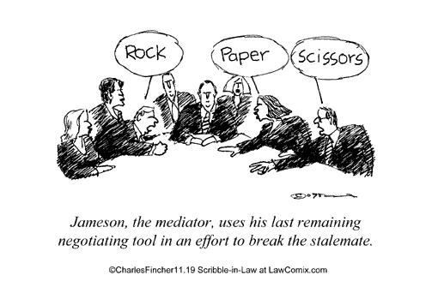
If they were not willing to discuss settlement or unsuccessful negotiations, then you may need to either prepare for TRIAL or consider MEDIATION as an option.
Remember folks – All of the Tax Court Judges have undergone Mediation training.
The criteria for mediation is essentially that the parties are far enough along that what is discussed is the case that would be tried.
The judges will be selective in terms of what cases they will hear in mediation. As it stands, they feel that they have been successful in settling several cases.
Mediation can be cost effective for both parties.

Slide 48
Appraisal
Before beginning your report, gather ALL your resource documents and READ them
Identify the Bundle of Rights and expand your Highest and Best Use analysis
  Carry that analysis throughout your report
Include all of the supporting documentation in your report
  Explain why it is there
Identify your theory
  Don’t assume court understands appraisal theory & appraisal practice
Identify your Market Rent
  Determine if the Contract Rents are in line with the Market Rents & if they are not, ADJUST for differences.

Slide 49
Don’t go to Trial to “teach a lesson” to the Petitioner or their Attorney

Slide 50
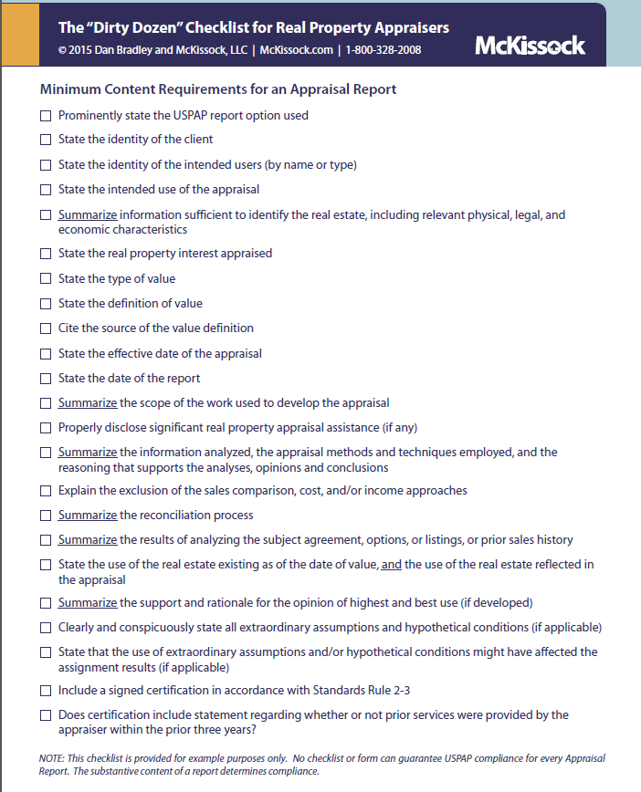
The “Dirty Dozen” Checklist for Real Property Appraisers

Slide 51
More To-Do’s
Verify each sale that you use within your report
  Identify the name of the person along with the date you spoke with them
Use your resources
  Phone a Friend (reach out to them, get their perspective of your case)
Check your Math and Rates.
Analyze your report once it is written – Do you have a good strong case?
Before submission
  Have another appraiser thoroughly review your report
Read the results of other cases similar to yours
  Is there something that you could add to enhance your verbiage,
  maybe build up an area that you feel is weak?

Slide 52
Appraisal Review
What to do:
Be The WORST Critic
Review the report page by page, section by section
  Grab your “Dirty Dozen” checklist to make sure that all of the requirements have been met.
  Make sure that ALL of the data discussed within the report is included in the report.
  Is the Market Data discussed and documented reflective of the Current Market as of the effective date of the report?
  Is the Highest and Best Use analysis conveyed adequately or superlatively? You may need to expand this analysis depending on your subject.
  Does that Highest and Best Use flow throughout the report?
  Cost Approach formula and rates used, are they accurate and reflective of the subject?
  Verify each Sales Comparable and adjustment calculation applied.
  Verify the Income Approach formula(s) and CAP Rate Comparables

Slide 53
You are asked to review the Petitioners Appraisal Report.
USPAP – STANDARD 3
APPRAISAL REVIEW, DEVELOPMENT AND REPORTING
This presenter is not the USPAP expert, or USPAP police.
My question to you: Does USPAP Standard 3 apply? If so, How?
If Not, Why Not?

Slide 54
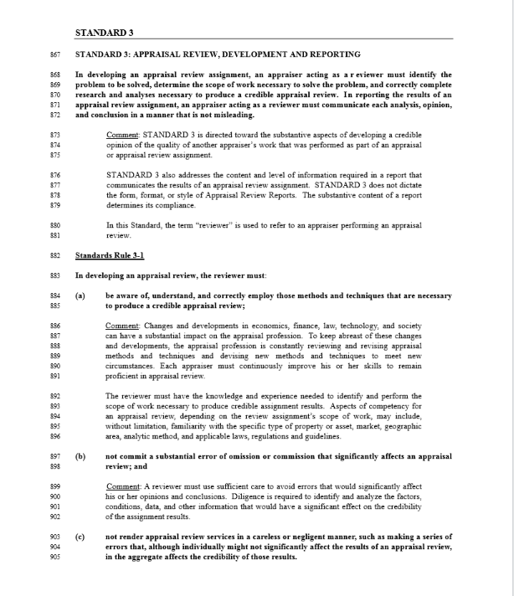

Slide 55
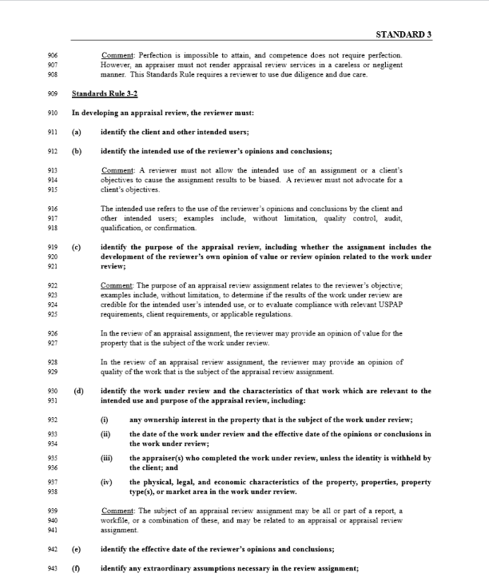

Slide 56
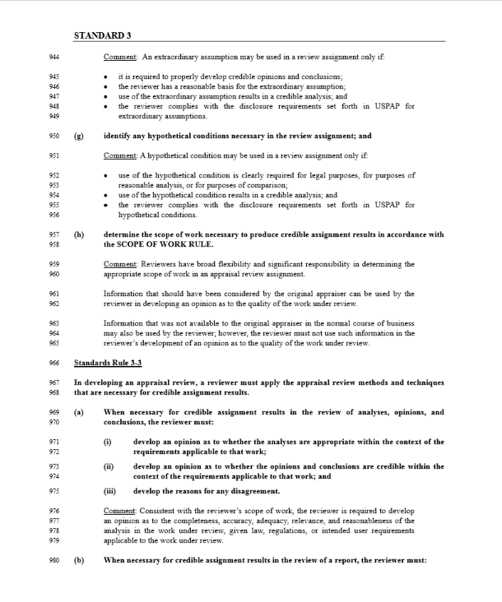

Slide 57
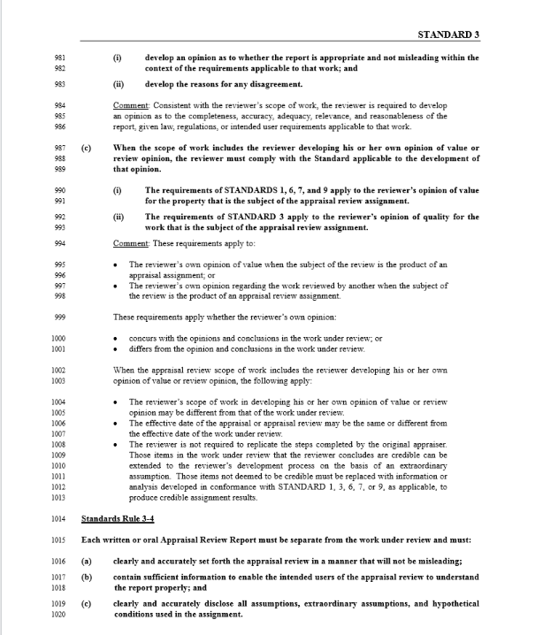

Slide 58
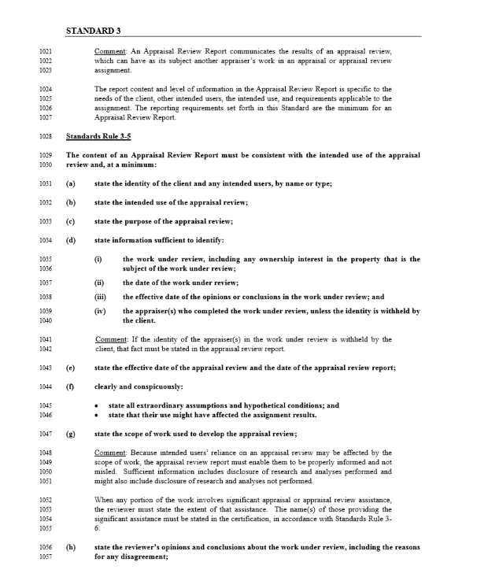

Slide 59
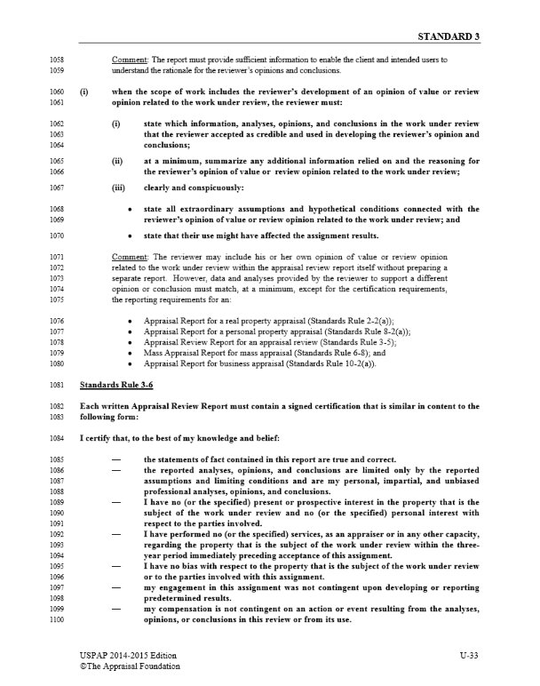

Slide 60
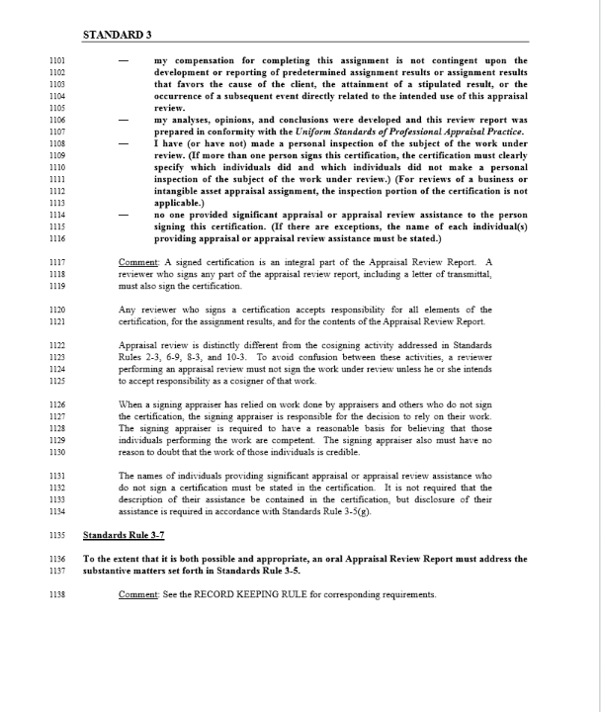

Slide 61
TRIAL

Slide 62

What’s your WORST FEAR when it comes to Tax Court?

Slide 63
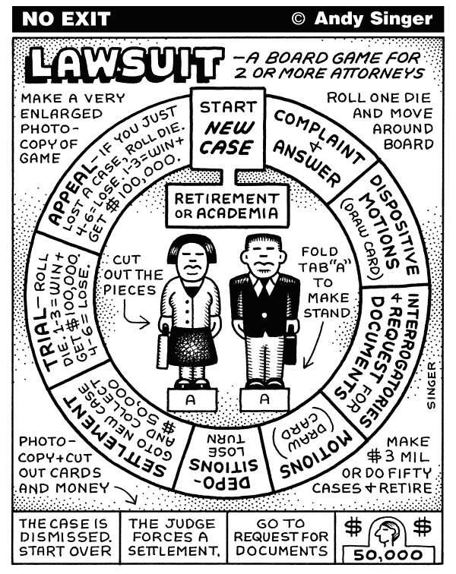
TAX COURT IS NO GAME
YOUR APPRAISAL IS YOUR DIRECT TESTIMONY
INCLUDE EVERYTHING WITHIN YOUR REPORT
THE CASE THAT YOU BRING BEFORE THE COURT MAY IMPACT THE REST OF
THE STATE (EVERY CASE IS DIFFERENT)

Slide 64
Trial
Trial is not a personal attack on you
  Although difficult, speak clearly and answer the question
Always convey confidence!
  If you believe in your report and convey that with confidence,
  they will hear that in your answers
KNOW YOUR REPORT
  You will have your copy of your report with you on the stand
  On each page, place tabs with labels in areas of potential importance
  Write your formulas on each page

Slide 65
More Trial Tips
KNOW YOUR APPROACHES, MATH & FORMULAS
  Opposing counsel will try to manipulate the approaches, math & formulas to their advantage
  They will ask why you did or did not include a “dollar amount” here or there
  If you know your formulas and you know why, write that answer on that page so that you do not have to think quickly under pressure
It is ok to read from your report
Although difficult, if opposing counsel trips themselves up on their line of questioning, don’t correct them or help them

Slide 66
Only answer the question asked
If it’s a YES or NO question, only give a Yes or No answer.

Slide 67

Best Practices Tips – Please Share…

Slide 68
Any Questions?
Contact Information:
Ann Miller, S.A.M.A.
Washington County PRTS
ann.miller@co.washington.mn.us
651-275-7524

